Slide 1
OFFICE OF U.S. REPRESENTATIVE ED CASE
01
Alzheimer’s and
Dementia Priorities
for Hawaiʻi
DETECT
02
EQUIP
Discussion with Alan Muneoka
Office of Congressman Ed Case
A 30-minute conversation
03
DELIVER
One connected pathway
Jerry Perone and Community Team, September 14, 2026
Notes:
TIMING: 0:00–1:05
PURPOSE: Welcome Alan Muneoka as the office’s representative and establish the meeting’s purpose.
DELIVERY SCRIPT — READ OR CLOSELY FOLLOW:
“Aloha, Alan, and mahalo for meeting with us and representing Congressman Case’s office. We appreciate the Congressman’s support and your time today.
Our purpose is to connect the experiences of Hawaiʻi families affected by dementia with three complementary initiatives: ASAP, AADAPT, and the Hānai Memory Network. We would value your perspective on where matters stand, what information would be useful to the office, and where our team can help.
We hope to leave with a few practical next steps and a clear understanding of anything you would like to take back to the Congressman.”
PRESENTER CUE — DO NOT READ:
Address Alan directly. He is the sole attendee from Congressman Case’s office. Treat this as a working discussion with him. Allow time for a brief acknowledgment.
IF RUNNING LONG:
“Aloha, Alan, and mahalo for representing the office. We hope to connect Hawaiʻi families’ experiences with ASAP, AADAPT and Hānai, hear your guidance, and agree on useful follow-up.”
TRANSITION:
“Here is how we propose to use our 30 minutes.”

Slide 2
MEETING FLOW
Six purposeful moves in 30 minutes
Desired outcome: Alan’s guidance, agreed actions and questions for the Congressman.
0:00-0:02 | Welcome, purpose and desired outcomes | 2 min
0:02-0:04 | Introductions: Alan Muneoka and our team | 2 min
0:04-0:12 | Personal or professional story round | 8 min
0:12-0:21 | Hawaiʻi needs + ASAP + AADAPT + Hānai | 9 min
0:21-0:27 | Alan’s perspective and guidance on next steps | 6 min
0:27-0:30 | Agreed actions, questions to take back and target dates | 3 min
Jerry Perone, September 14, 2026
2
Notes:
TIMING: 1:05–2:00
PURPOSE: Confirm the meeting flow and protect time for Alan’s guidance and follow-up.
DELIVERY SCRIPT — READ OR CLOSELY FOLLOW:
“We will begin with introductions, followed by a voluntary story round. We have then set aside nine minutes to connect Hawaiʻi’s needs with ASAP, AADAPT and the Hānai Memory Network.
At minute twenty-one, we would like to turn the floor to you, Alan, for your perspective and guidance. We will protect the final three minutes for agreed actions and any questions you would like to take back to the Congressman or other staff.
Please redirect us if another issue would be more useful. If we finish the stories early, we can give that time to the discussion.”
PRESENTER CUE — DO NOT READ:
Point briefly to the agenda. Keep introductions within the next two minutes. Preserve the closing three minutes even if earlier discussion expands.
IF RUNNING LONG:
“We will move from introductions and voluntary stories to the policy discussion, then hear your guidance and confirm follow-up.”
TRANSITION:
“Alan, would you like to introduce yourself first, then we will introduce our team?”

Slide 3
INTRODUCTIONS + STORY ROUND
Every seat brings a reason this work matters
Alan Muneoka and our team: name, role and connection.
Everyone is welcome to pass.
01
02
03
60 SECONDS
ONE CHANGE
LISTEN FOR THEMES
A personal story or professional connection to Alzheimer’s or dementia.
What single change would make the greatest difference?
Where do our experiences point to the same broken handoff?
Sharing is voluntary. A personal story, professional connection or constituent theme is welcome.
Jerry Perone, September 14, 2026
3
Notes:
TIMING: 2:00–12:00
PURPOSE: Introduce Alan and the team, invite voluntary sharing, and identify the change each participant most wants to see.
DELIVERY SCRIPT — INTRODUCTIONS, 2:00–4:00:
“Alan, thank you again for joining us. Please introduce yourself and your work with the office. We will then go around our team with each person’s name, role and connection to this work.”
[After Alan, introduce yourself in no more than 20 seconds and invite each team member in turn.]
DELIVERY SCRIPT — STORY ROUND INVITATION, 4:00–5:00:
“I would now like to invite each person to share up to 60 seconds about a personal experience or professional connection to Alzheimer’s or dementia. If you choose to share, please end with one change that would make the greatest difference. Anyone may pass, with no explanation needed.
Alan, you are very welcome to share a personal or professional connection if you wish, but there is absolutely no expectation that you do so. We would also welcome anything you are hearing from constituents about dementia and caregiving, without identifying individual constituents.”
FACILITATOR CUES — DO NOT READ:
• Model the format first if helpful. Never call on someone who has passed.
• At about 50 seconds, give a gentle signal. At 60 seconds, say, “Mahalo. May I ask for your one change?”
• Acknowledge contributions briefly and capture repeated themes without trying to solve each story in the moment.
• Allow only as many 60-second stories as the remaining time permits. Invite additional contributions in follow-up if necessary.
• If the round finishes early, move into the policy discussion and use the saved time for Alan’s guidance.
DELIVERY SCRIPT — AFTER THE ROUND, BY 12:00:
“Mahalo. I heard [name two or three themes, such as earlier answers, a trusted local provider, caregiver navigation or less neighbor-island travel]. Those experiences show us where families need better connections between concern, diagnosis and care.”
IF RUNNING LONG:
“I want to protect time for the policy discussion and Alan’s guidance. I will pause the round here, and we can capture any remaining stories in follow-up.”
TRANSITION:
“Let us look at the size of the need and where the path to care breaks down.”

Slide 4
THE NEED
Hawaiʻi’s pathway breaks at key handoffs
Families encounter delays at several handoffs: detection, diagnosis, specialty access, care planning and long-term support.
31,000+
62,000+
$309M
Residents living with Alzheimer’s
Projected by 2050
Annual Medicaid cost
A statewide challenge already affecting thousands of households.
The number is expected to more than double without a coordinated response.
Dementia-related spending is already pressuring public and family budgets.
Neighbor-island access gaps and limited specialty capacity can turn early warning signs into late, crisis-driven care.
Source: State of Hawaiʻi Office of the Governor, July 14, 2026
4
Notes:
TIMING: 12:00–13:30
PURPOSE: Frame Hawaiʻi’s challenge as both scale and fragmented access to care.
DELIVERY SCRIPT — READ OR CLOSELY FOLLOW:
“Hawaiʻi’s challenge is not only the size of the population affected. It is the broken path from concern to care.
The Governor’s July 2026 release cited more than 31,000 residents living with Alzheimer’s, projected to exceed 62,000 by 2050, and roughly 309 million dollars a year in dementia-related Medicaid costs.
Families encounter delay at several points: recognizing concern, accessing an appropriate test, finding a prepared provider, obtaining specialty input, receiving a care plan, and staying connected to support. On the neighbor islands, travel and scarce specialty capacity intensify every delay.
So the real policy question is: how do we repair the sequence rather than fund isolated pieces?”
PRESENTER CUE — DO NOT READ:
Pause briefly after the three numbers. Then shift attention from prevalence to the broken handoffs shown on the slide.
IF RUNNING LONG:
“More than 31,000 Hawaiʻi residents live with Alzheimer’s today, and the figure is projected to exceed 62,000 by 2050. The central challenge is the broken sequence from concern to testing, a prepared provider, a care plan, and continuing support—especially on the neighbor islands.”
TRANSITION:
“That is where the three initiatives fit together.”
[Sources]
- https://governor.hawaii.gov/newsroom/office-of-the-governor-news-release-gov-green-signs-legislation-to-support-kupuna-care-and-strengthen-ai-protection/
[/Sources]

Slide 5
FEDERAL-STATE ALIGNMENT
A complete pathway needs all three pieces
Each initiative solves a different break in the sequence. None substitutes for the others.
DETECT
EQUIP
DELIVER
ASAP
AADAPT
Hānai
Medicare coverage for qualifying FDA-approved blood-based dementia screening tests.
Project ECHO virtual education that builds dementia capability in primary care.
County specialists, neighbor-island memory clinics, navigation and ongoing care.
Federal payment
Federal workforce
State delivery
Earlier signal → capable clinician → coordinated care
Sources: GovInfo; State of Hawaiʻi; Alzheimer’s Association Hawaiʻi
5
Notes:
TIMING: 13:30–15:00
PURPOSE: Show that ASAP, AADAPT, and Hānai are complementary parts of one pathway.
DELIVERY SCRIPT — READ OR CLOSELY FOLLOW:
“ASAP, AADAPT, and Hānai are not competing proposals. Each solves a different break in the pathway.
ASAP is the detection and coverage piece: Medicare payment for qualifying FDA-approved blood-based dementia screening tests.
AADAPT is the provider-capacity piece: Project ECHO education that helps primary-care clinicians detect, diagnose, discuss treatment, and manage ongoing care.
Hānai is the Hawaiʻi delivery piece: county dementia care specialists, neighbor-island memory clinics, navigation, a care plan, and long-term support.
Federal payment without trained providers can produce a test result with nowhere to go. Training without local referral infrastructure can produce a knowledgeable clinician with no accessible pathway. And Hānai without broader coverage and workforce support can be overwhelmed.
Together, they form a complete sequence: detect, equip, deliver.”
PRESENTER CUE — DO NOT READ:
Move left to right through the diagram. Emphasize the connections and handoffs, not three separate legislative summaries.
IF RUNNING LONG:
“ASAP covers the detection tool. AADAPT equips the provider. Hānai delivers navigation and care locally. None is sufficient alone; together they create the sequence from concern to continuing support.”
TRANSITION:
“Let me take each piece briefly, beginning with detection.”
[Sources]
- https://www.govinfo.gov/app/details/BILLS-119hr6130ih
- https://www.govinfo.gov/app/details/BILLS-119hr3747rh
- https://governor.hawaii.gov/newsroom/office-of-the-governor-news-release-gov-green-signs-legislation-to-support-kupuna-care-and-strengthen-ai-protection/
- User-provided Hānai Memory Network infographic, Alzheimer’s Association Hawaiʻi
[/Sources]

Slide 6
1 • DETECT
ASAP makes earlier detection more reachable
Why it matters in Hawaiʻi
ASAP
Lower the coverage barrier for an emerging, less invasive testing pathway.
Create an earlier opening for evaluation, treatment discussions and planning.
Extend reach statewide when testing is paired with trained providers and referral capacity.
H.R. 6130 • S. 3267
Would provide Medicare coverage for qualifying FDA-approved blood-based dementia screening tests.
Thank you: Congressman Case is a cosponsor.
House status, Sept. 8
Alan: What local evidence would help the office assess the next step for ASAP?
At Energy & Commerce and Ways & Means
Sources: GovInfo bill-status records, verified September 8, 2026
6
Notes:
TIMING: 15:00–16:45
PURPOSE: Explain ASAP, acknowledge Congressman Case’s cosponsorship through Alan, and ask what evidence would help the office.
LEGISLATIVE STATUS VERIFIED: September 8, 2026
DELIVERY SCRIPT — READ OR CLOSELY FOLLOW:
“ASAP is the detection piece. H.R. 6130, with S. 3267 in the Senate, would provide Medicare coverage for qualifying FDA-approved blood-based dementia screening tests.
For Hawaiʻi, coverage could create an earlier opening for evaluation, treatment discussions and planning. A screening result still needs appropriate clinical evaluation and support.
As of September 8, the House bill remained before Energy and Commerce and Ways and Means. It had 206 cosponsors, eight more than on August 28. The Senate bill remained before Finance with 48 cosponsors.
Please convey our appreciation to Congressman Case for cosponsoring ASAP. From your perspective, what would be most useful from us now: local evidence, constituent experiences, or connections with Hawaiʻi clinicians? Is there a particular question we could help the office answer?”
PRESENTER CUE — DO NOT READ:
Keep the legislative status date attached to the figures. Do not imply that screening alone establishes a diagnosis. Capture Alan’s initial guidance briefly and return to it during slide 9 if more discussion is needed.
REFERENCE IF ASKED — DO NOT READ UNLESS USEFUL:
• Case joined H.R. 6130 on May 11, 2026. Senator Hirono joined S. 3267 on June 1, 2026.
• Eight House additions since August 28: Seth Magaziner, Michael Rulli, Nellie Pou and Rudy Yakym on August 31, then Vince Fong, Sheri Biggs, Juan Vargas and Laura Gillen on September 4. Four Democrats and four Republicans.
• September 8 counts exclude the sponsors: House 206 (128 D, 77 R, 1 I), Senate 48 (26 D, 22 R).
• Senator Schatz was not listed on S. 3267 in the September 8 record. Ask about coordination without assuming his position.
IF RUNNING LONG:
“ASAP would cover qualifying blood-based dementia screening tests under Medicare. Please thank Congressman Case for cosponsoring it. Alan, what evidence or local connection would help the office assess the next step?”
TRANSITION:
“Coverage creates access to the tool. AADAPT helps equip the provider to respond.”
[Sources]
- https://www.govinfo.gov/bulkdata/BILLSTATUS/119/hr/BILLSTATUS-119hr6130.xml
- https://www.govinfo.gov/bulkdata/BILLSTATUS/119/s/BILLSTATUS-119s3267.xml
- https://www.congress.gov/bill/119th-congress/house-bill/6130/cosponsors
- https://www.congress.gov/bill/119th-congress/senate-bill/3267/cosponsors
- https://www.govinfo.gov/app/details/BILLS-119hr6130ih
[/Sources]

Slide 7
2 • EQUIP
AADAPT equips Hawaiʻi’s dementia workforce
Why it fits Hawaiʻi
AADAPT
Remote and scalable: specialists can mentor community providers without requiring travel.
Primary-care centered: builds skill where most people first raise a memory concern.
Useful across the continuum: detection, diagnosis, treatment and ongoing person-centered care.
H.R. 3747 • S. 4036
Reauthorizes Project ECHO and explicitly adds dementia care to the program’s specialty focus.
Thank you: Congressman Case cosponsored the House-passed bill.
H.R. 3747 status
Alan: How can we help with Senate coordination and Hawaiʻi training readiness?
House passed. At Senate HELP since July 21, 2026
Sources: GovInfo bill-status records, verified September 8, 2026
7
Notes:
TIMING: 16:45–18:30
PURPOSE: Explain AADAPT’s workforce value and ask Alan about Senate coordination and Hawaiʻi training readiness.
LEGISLATIVE STATUS VERIFIED: September 8, 2026
DELIVERY SCRIPT — READ OR CLOSELY FOLLOW:
“AADAPT is the workforce piece. It uses Project ECHO, structured remote education that connects community providers with dementia experts.
This is a strong fit for an island state. Specialists can help community providers strengthen their skills in detection, diagnosis, treatment conversations and continuing care without requiring every clinician to travel.
The House passed H.R. 3747 by voice vote on July 20. It went to the Senate HELP Committee on July 21. As of September 8, it remained there, with 97 House cosponsors. The separate Senate companion, S. 4036, also remained before HELP with nine cosponsors.
We also appreciate Congressman Case’s support for AADAPT. With the House bill awaiting Senate action, where could our Hawaiʻi team be helpful? Would it be useful to document local training needs or bring together providers who could explain how this model would work across the islands?”
PRESENTER CUE — DO NOT READ:
Say that Congressman Case cosponsored the House bill. Do not describe a voice vote as an individual recorded vote. HELP means Health, Education, Labor, and Pensions. Any implementation discussion concerns readiness should the federal legislation become law.
REFERENCE IF ASKED — DO NOT READ UNLESS USEFUL:
• Case joined H.R. 3747 on May 12, 2026.
• September 8 counts exclude sponsors: H.R. 3747 has 97 cosponsors (74 D, 23 R). S. 4036 has nine (5 D, 4 R).
• S. 4036 went to HELP on March 10, 2026. Its cosponsors are Amy Klobuchar, Jerry Moran, James Lankford, Dan Sullivan, Andy Kim, Cory Booker, Maria Cantwell, John Boozman and Christopher Coons.
• Neither Hawaiʻi senator appeared on S. 4036’s September 8 cosponsor list. Do not assume that absence establishes opposition.
IF RUNNING LONG:
“AADAPT brings dementia expertise to community providers through Project ECHO. The House bill awaits Senate action. Please thank Congressman Case for cosponsoring it. Alan, could we help with Senate coordination or evidence of local training needs?”
TRANSITION:
“A prepared provider also needs a local system for referral, planning and continuing support.”
[Sources]
- https://www.govinfo.gov/bulkdata/BILLSTATUS/119/hr/BILLSTATUS-119hr3747.xml
- https://www.govinfo.gov/bulkdata/BILLSTATUS/119/s/BILLSTATUS-119s4036.xml
- https://www.congress.gov/bill/119th-congress/house-bill/3747/cosponsors
- https://www.congress.gov/bill/119th-congress/senate-bill/4036/cosponsors
- https://www.govinfo.gov/app/details/BILLS-119hr3747rh
- https://www.govinfo.gov/content/pkg/BILLS-119s4036is/pdf/BILLS-119s4036is.pdf
[/Sources]

Slide 8
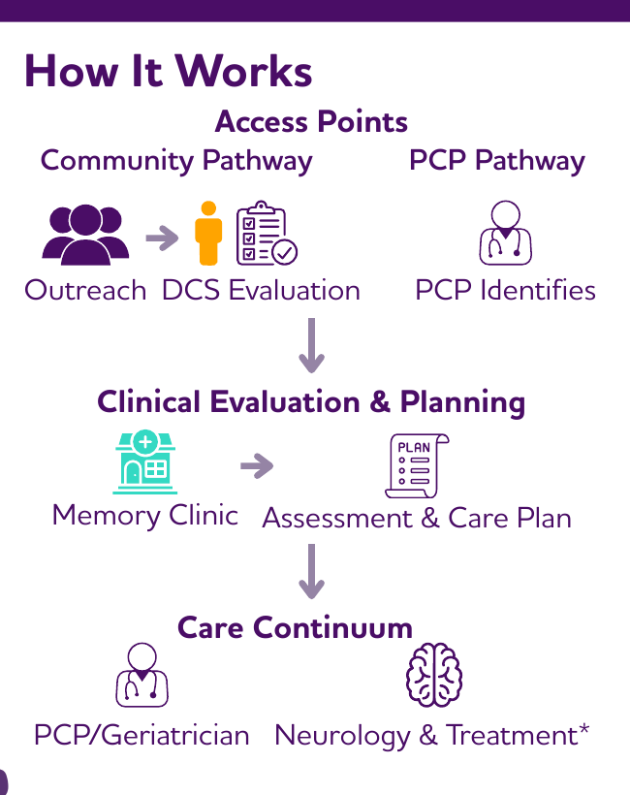
3 • DELIVER
Hānai brings coordinated care closer to home
HB 1853 / Act 245 established Hawaiʻi’s Assistance for the Navigation of Alzheimer’s Intervention within the Executive Office on Aging.
$3 million appropriation for implementation
Dementia care specialist in each county
Community-based memory clinics on the neighbor islands
Two entry paths—community outreach and primary care—leading to evaluation, a care plan and ongoing support
Source visual: Alzheimer’s Association Hawaiʻi
ASAP opens the test. AADAPT strengthens the clinician. Hānai keeps the family from navigating alone.
Sources: State of Hawaiʻi; user-provided Hānai Memory Network infographic
8
Notes:
TIMING: 18:30–21:00
PURPOSE: Explain Hānai as the local delivery infrastructure and connect all three initiatives through the handoffs.
DELIVERY SCRIPT — READ OR CLOSELY FOLLOW:
“Hānai is the delivery piece. Governor Green signed HB 1853 as Act 245 on July 14, 2026. It established Hawaiʻi’s Assistance for the Navigation of Alzheimer’s Intervention in the Executive Office on Aging and appropriated three million dollars.
The design places a dementia care specialist in each county and provides community-based memory clinics on the neighbor islands. A person can enter through community outreach or primary care. Those paths converge on clinical evaluation, an assessment and care plan, and a continuum involving primary care, geriatrics, neurology, treatment, and caregiver support.
This is the practical relationship among the three policies: ASAP opens access to the test. AADAPT strengthens the clinician. Hānai keeps the person and family from navigating the result alone. The value lies in the handoffs.”
DISCUSSION PROMPT — READ IF TIME ALLOWS:
“Alan, from the office’s perspective, where is the most important federal-state connection to strengthen as Hānai moves into implementation?”
PRESENTER CUE — DO NOT READ:
Allow up to 30 seconds for a response. If the response opens a larger discussion, note it for slide 9 rather than solving it here.
IF RUNNING LONG:
“Hānai is the delivery infrastructure: a dementia care specialist in each county, neighbor-island memory clinics, navigation, a care plan, and continuing support. ASAP opens access, AADAPT equips the clinician, and Hānai connects the person and family to care.”
TRANSITION:
“That is our framing. Alan, we would now like to turn the conversation to you.”
[Sources]
- https://governor.hawaii.gov/newsroom/office-of-the-governor-news-release-gov-green-signs-legislation-to-support-kupuna-care-and-strengthen-ai-protection/
- User-provided Hānai Memory Network infographic, Alzheimer’s Association Hawaiʻi
[/Sources]

Slide 9
YOUR PERSPECTIVE
Alan’s guidance: where can we be useful?
01
What priorities or opportunities would you like us to understand?
Listen
first.
02
What information would help you take these issues back to the Congressman?
Information, priorities, concerns and opportunities are all useful to us.
03
Where could our team help with local evidence or partner connections?
We can provide a concise written follow-up for you to share within the office.
Jerry Perone, September 14, 2026
9
Notes:
TIMING: 21:00–27:00
PURPOSE: Hear Alan’s perspective and identify useful support for the office, including questions for further consideration.
DELIVERY SCRIPT — OPEN THE DISCUSSION:
“Alan, we would now like to turn the conversation to you. What priorities, concerns, or opportunities would you like us to understand? Where could our team be useful to the office?
If there are questions you would prefer to take back to the Congressman or other staff, we can capture those and provide a short written follow-up.”
FACILITATOR CUES — DO NOT READ:
Pause and let Alan choose where to begin. Leave room for him to explain both opportunities and constraints.
Use only the follow-up prompts that help:
• “What would useful support look like?”
• “What local evidence would help you discuss this within the office?”
• “Is there a deadline or decision point we should work backward from?”
• “Who else would you suggest involving?”
• “Would you like that recorded as a question for further consideration?”
About one minute before moving on, summarize:
“Let me check that I have this right. I heard [priority or concern], [useful contribution from our team], and [question to take back, if any]. Did I capture that accurately?”
IF DISCUSSION RUNS LONG:
At 27:00 say: “Alan, I want to honor our time and capture the follow-up accurately. May we move to the action review and carry any unfinished questions into our written summary?”
TRANSITION:
“Let us record the next steps and the questions that need further consideration.”

Slide 10
CLOSE WITH CLARITY
Agreed actions and questions to take back
Record each item as Agreed, For consideration or Open. Confirm the next contact and date.
Action or question | Owner / contact | Status / input needed | Follow-up date
ASAP: evidence or next step for the office | — | — | —
AADAPT: Senate coordination or training needs | — | — | —
Hānai: federal-state coordination question | — | — | —
Written summary and next check-in | — | — | —
Jerry Perone, September 14, 2026
10
Notes:
TIMING: 27:00–29:35
PURPOSE: Record agreed actions separately from matters Alan will take back, and confirm contacts and realistic follow-up dates.
DELIVERY SCRIPT — OPEN THE ACTION REVIEW:
“Let us separate the next steps we can agree on today from the questions that need further consideration. For each item, who will follow up, what information is needed, and when would it be reasonable to reconnect?”
FACILITATOR CUES — DO NOT READ:
The rows are prompts, not commitments. Replace them with the actual outcome of the discussion.
Use the Status / input needed column to record:
• Agreed: the named person accepts the action.
• For consideration: Alan will raise the question with the Congressman or appropriate staff. This is not an office commitment to the underlying request.
• Open: the question still needs an answer or an owner.
Record any needed information in the same cell. Confirm the contact and date for a reply or status update, rather than assuming a policy decision by that date.
DELIVERY SCRIPT — ROW-BY-ROW PROMPTS:
“What exactly is the action or question?”
“Is this agreed, for consideration, or still open?”
“Who will make the next contact, and what information is needed?”
“What is a reasonable follow-up date?”
DELIVERY SCRIPT — READBACK:
“Let me read back what we have agreed to do, followed by the questions for further consideration: [read the items, contacts and dates]. Is that accurate?
Alan, what would make our follow-up easiest for you to use and share within the office? What is your preferred channel? Should we set a check-in now, or reconnect after the next step?”
IF NO ACTION IS READY:
“That is fine. I will send a concise summary of the questions and information needs we heard today. We will identify what remains open and avoid assigning commitments we have not agreed.”
IF RUNNING LONG:
Confirm the highest-priority item and say: “We will include the remaining open questions in the written summary for confirmation.”
TRANSITION:
“Alan, thank you. I will close with our appreciation.”

Slide 11
A COMPLETE PATHWAY FOR HAWAIʻI
Within reach.
Mahalo, Alan
Thank you for your time and guidance. Please convey our appreciation to Congressman Case.
DETECT EARLIER
EQUIP PROVIDERS
DELIVER CARE STATEWIDE
Jerry Perone
September 14, 2026
Notes:
TIMING: 29:35–30:00
PURPOSE: Thank Alan directly and close with a clear commitment to the agreed follow-up.
DELIVERY SCRIPT — READ IF TIME REMAINS:
“Alan, mahalo for your time and guidance. Please convey our appreciation to Congressman Case for his support of ASAP and AADAPT. We will send a concise summary of today’s discussion and the next steps we agreed.”
PRESENTER CUE — DO NOT READ:
End cleanly and leave this slide visible. The closing should respect Alan’s role and the commitments actually made during the meeting.
IF TIME HAS EXPIRED:
“Mahalo, Alan. Please thank Congressman Case on our behalf. We will follow up on the actions and questions we recorded.”

Slide 12
APPENDIX: STATUS VERIFIED SEPTEMBER 8, 2026
Policy status at a glance
Initiative | Purpose | Legislative status | Cosponsors | Question for Alan
ASAP H.R. 6130 / S. 3267 | Medicare coverage for qualifying FDA-approved blood-based dementia screening tests | House: Energy & Commerce and Ways & Means Senate: Finance | House: 206 Senate: 48 Case: H.R. 6130 | What evidence would help the office assess next steps?
AADAPT H.R. 3747 / S. 4036 | Project ECHO capacity for dementia training and care | House passed July 20 H.R. 3747 and S. 4036: Senate HELP | House: 97 Senate: 9 Case: H.R. 3747 | How can we help with Senate coordination and training readiness?
Hānai HB 1853 / Act 245 | Statewide navigation, memory clinics, care plans and continuing support | Signed July 14, 2026 $3 million appropriated | Not applicable Enacted state law | Where could federal policy support implementation?
Official sources and presenter citations are included in slide notes
12
Notes:
APPENDIX — USE IF ALAN OR THE TEAM ASKS FOR BILL NUMBERS, STATUS OR COSPONSORS
STATUS DATE: September 8, 2026
MEETING DATE: September 14, 2026
DELIVERY SCRIPT — IF THIS SLIDE IS USED:
“This appendix brings the status together as verified on September 8. ASAP’s House bill remained in Energy and Commerce and Ways and Means, with 206 cosponsors. Its Senate companion remained in Finance, with 48.
AADAPT’s H.R. 3747 passed the House by voice vote on July 20 and went to Senate HELP on July 21. Its House cosponsor count was 97. The separate S. 4036 was also before HELP, with nine cosponsors.
Hānai is enacted in Hawaiʻi. Governor Green signed HB 1853 as Act 245 on July 14 and the measure appropriated three million dollars for implementation.
Congressman Case cosponsors both federal House bills. Alan, we would value your guidance on what information could help the office assess next steps and support the connection between federal policy and Hawaiʻi’s care system.”
PRESENTER CUE — DO NOT READ:
Use this as a reference, then return to the discussion or action slide. Counts exclude each bill’s sponsor. Keep the verification date explicit. Distinguish federal proposals awaiting enactment from Hawaiʻi’s enacted program.
CHANGES FROM THE AUGUST 28 BASELINE:
• No new committee, floor or enactment action was identified in the September 8 check.
• H.R. 6130 increased from 198 to 206 cosponsors. Four joined August 31 and four September 4, evenly divided between Democrats and Republicans.
• The other three federal cosponsor counts did not change.
HAWAIʻI DELEGATION REFERENCE AS OF SEPTEMBER 8:
• Case: H.R. 6130 since May 11, 2026, and H.R. 3747 since May 12, 2026.
• Hirono: S. 3267 since June 1, 2026.
• Schatz was not listed on S. 3267. Neither Hawaiʻi senator was listed on S. 4036.
• Absence from a cosponsor list does not establish a member’s position on the bill.
IF ASKED WHAT SUPPORT WOULD HELP:
“Alan, would a short local evidence brief, provider input or a coordination question for the appropriate staff be most useful? We can record anything you would like to take back for consideration.”
[Sources]
- https://www.govinfo.gov/bulkdata/BILLSTATUS/119/hr/BILLSTATUS-119hr6130.xml
- https://www.govinfo.gov/bulkdata/BILLSTATUS/119/s/BILLSTATUS-119s3267.xml
- https://www.congress.gov/bill/119th-congress/house-bill/6130/cosponsors
- https://www.congress.gov/bill/119th-congress/senate-bill/3267/cosponsors
- https://www.govinfo.gov/app/details/BILLS-119hr6130ih
[/Sources]
[Sources]
- https://www.govinfo.gov/bulkdata/BILLSTATUS/119/hr/BILLSTATUS-119hr3747.xml
- https://www.govinfo.gov/bulkdata/BILLSTATUS/119/s/BILLSTATUS-119s4036.xml
- https://www.congress.gov/bill/119th-congress/house-bill/3747/cosponsors
- https://www.congress.gov/bill/119th-congress/senate-bill/4036/cosponsors
- https://www.govinfo.gov/app/details/BILLS-119hr3747rh
- https://www.govinfo.gov/content/pkg/BILLS-119s4036is/pdf/BILLS-119s4036is.pdf
[/Sources]
[Sources]
- https://governor.hawaii.gov/newsroom/office-of-the-governor-news-release-gov-green-signs-legislation-to-support-kupuna-care-and-strengthen-ai-protection/
[/Sources]

Slide 13
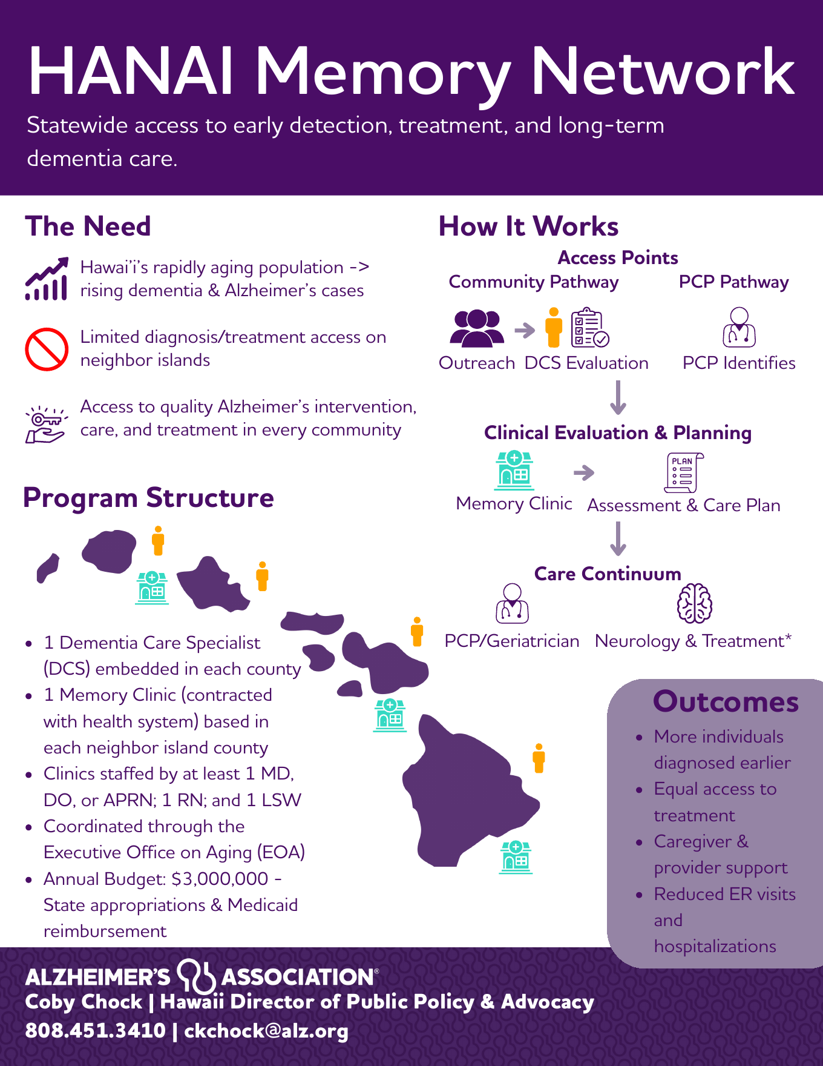
APPENDIX • HANDOUT REFERENCE
Hānai Memory Network source infographic
What the handout makes clear
Access points: community outreach or primary care
Evaluation: specialist review and memory-clinic assessment
Plan: clinical evaluation and individualized care planning
Continuum: primary care, geriatrics, neurology, treatment and caregiver support
Statewide structure: county dementia care specialists and neighbor-island clinics
Use the original PDF as the leave-behind; this slide keeps the source visible inside the deck.
Source: Alzheimer’s Association Hawaiʻi, Hānai Memory Network infographic
13
Notes:
APPENDIX — USE ONLY IF STAFF WANTS TO SEE THE HĀNAI MODEL IN DETAIL
DELIVERY SCRIPT — IF THIS SLIDE IS USED:
“This is the source Hānai handout. It shows the two principal access paths—community outreach and primary care—the clinical evaluation and planning step, and the continuum of care and caregiver support.
The important point is not that every person follows an identical route. It is that wherever someone enters, there is a supported handoff to evaluation, an assessment and care plan, and appropriate ongoing services.”
PRESENTER CUE — DO NOT READ:
Trace the pathway from the top of the infographic downward. Do not attempt to read every label aloud. For distribution, use the original portrait PDF rather than printing this landscape appendix slide.
IF ASKED HOW THE FEDERAL BILLS RELATE:
“ASAP can improve access to a covered detection tool, AADAPT can strengthen the provider who interprets and acts on the concern, and Hānai can supply the local navigation and care infrastructure after that point.”
[Sources]
- User-provided Hānai Memory Network infographic, Alzheimer’s Association Hawaiʻi
[/Sources]

